Slide 1
A Comparison of rural apartments with city apartments

Slide 2
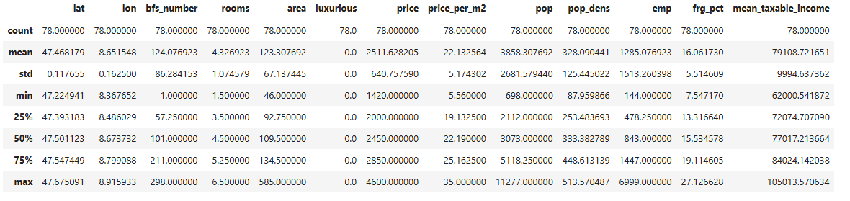
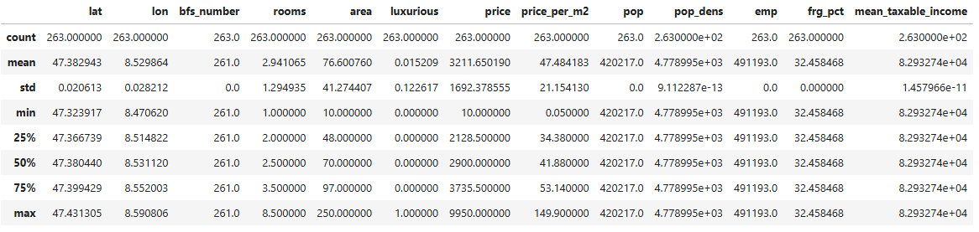
Boxplots of prices per m2
rural apartments
city apartments

Slide 3
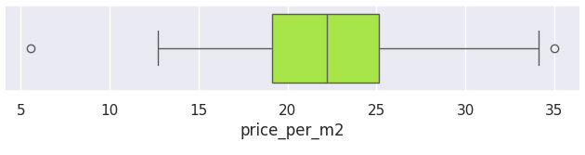
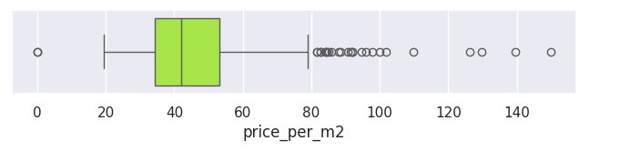
Boxplots of prices per m2
rural apartments
city apartments

Slide 4
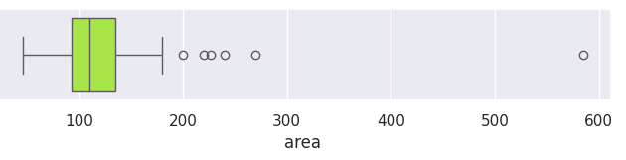
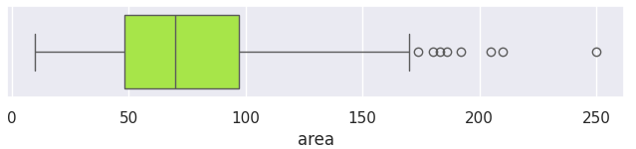
Boxplots of areas
rural apartments
city apartments

Slide 5
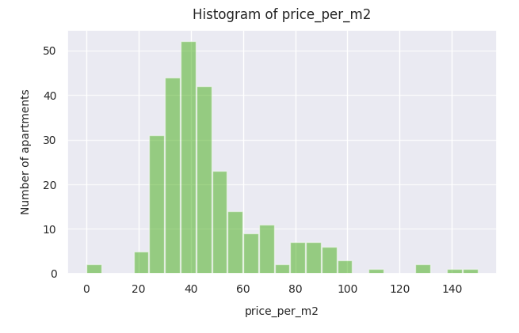
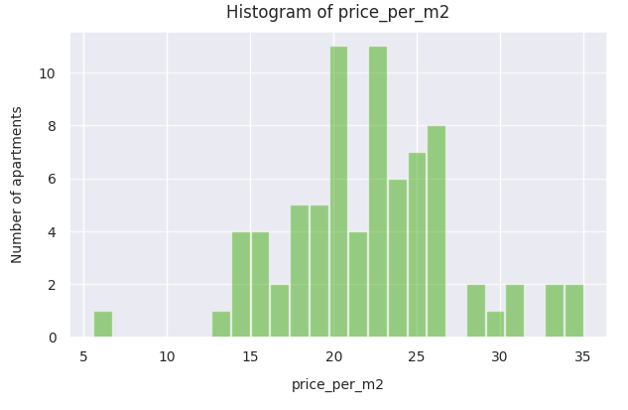
Histograms of prices per m2
rural apartments
city apartments

Slide 6
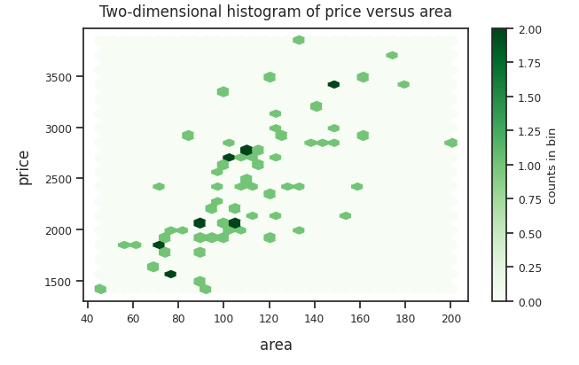
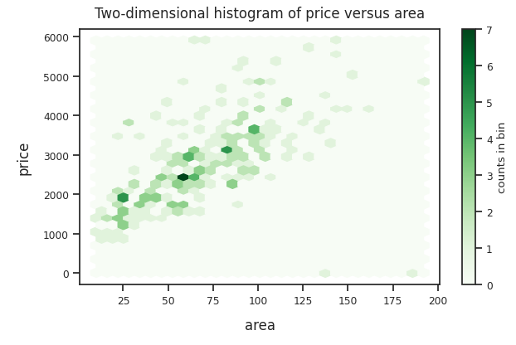
Histograms of areas
rural apartments
city apartments

